Slide 1


Peter Willcocks
6th February 2025

Slide 2

Outline
Executive Summary
Introduction
Methodology
Results
Conclusion
Appendix

Slide 3
Executive Summary
Summary of methodologies
Data Collection through API
Data Collection with Web Scraping
Data Wrangling
Exploratory Data Analysis with SQL
Exploratory Data Analysis with Data Visualization
Interactive Visual Analytics with Folium
Machine Learning Prediction
Summary of all results
Exploratory Data Analysis result
Interactive analytics in screenshots
Predictive Analytics result

Slide 4
Introduction
Project background and context
Space X advertises Falcon 9 rocket launches on its website with a cost of 62 million dollars; other providers cost upward of 165 million dollars each, much of the savings is because Space X can reuse the first stage. Therefore, if we can determine if the first stage will land, we can determine the cost of a launch. This information can be used if an alternate company wants to bid against space X for a rocket launch. This goal of the project is to create a machine learning pipeline to predict if the first stage will land successfully.
Problems you want to find answers
What factors determine if the rocket will land successfully?
The relationship between various features that determine the success rate of landings?
What operating conditions need to be in place to ensure a successful landing?

Slide 5

Section 1

Slide 6
Methodology
Executive Summary
Data collection methodology:
Data was collected using SpaceX API and web scraping from Wikipedia
Perform data wrangling
Missing values replaced with mean value for features
One-hot encoding was applied to categorical features
Perform exploratory data analysis (EDA) using visualization and SQL
Perform interactive visual analytics using Folium and Plotly Dash
Perform predictive analysis using classification models
How to build, tune, evaluate classification models

Slide 7
Data Collection
SpaceX API
Web scraping from Wikipedia
Get request from SpaceX API
Decoded Json file .json()
Converted to Pandas dataframe
Data cleaned- checking and replacing missing values
Webscraping falcon 9 launch records from wikipedia
Parsed table data with Beautiful Soup
Converted to Pandas dataframe

Slide 8
Data Collection – SpaceX API
https://github.com/pjwillcocks/Data-Science-Capstone-Project-/blob/9acdcea36d7045edb90a573b68ba1ed42a075b9f/1%20jupyter-labs-spacex-data-collection-api.ipynb
Get requests from SpaceX API for data using static json object
response = requests.get(static_json_url)
Decode response and convert to pandas dataframe
data = pd.json_normalize(response.json())
Used SapceX API calls to obtain additional data for Booster Version, Launch Site, Payload and Core
Populated dictionary with additional SpaceX API data and wanted from features from first dataframe
Converted dictionary into pandas dataframe

Slide 9
Data Collection - Scraping
https://github.com/pjwillcocks/Data-Science-Capstone-Project-/blob/9acdcea36d7045edb90a573b68ba1ed42a075b9f/2%20jupyter-labs-webscraping.ipynb
Get request from Falcon 9 Launch Wikipedia
response = requests.get(static_url).text
Parsed with Beautiful Soup
soup = BeautifulSoup(response, ‘htmal.parser’)
Extract of tables
Extract all column names
Create empty dictionary of column names
Extract and spend data into dictionary
Convert dictionary into pandas dataframe

Slide 10
Data Wrangling
First Stage – Deal with missing values in SpaceX API data
Second Stage – Assign categorical variable of success and failure to each flight
https://github.com/pjwillcocks/Data-Science-Capstone-Project-/blob/9acdcea36d7045edb90a573b68ba1ed42a075b9f/3%20labs-jupyter-spacex-Data%20wrangling.ipynb
Identify null values
Calculate mean value of feature with missing data
Replace missing data with mean value
Calculate number launches each site
Calculate number and occurrence of each orbit
Calculate mission outcome from each orbit
Create column and label for landing outcome, good or bad
Assign categorical variable for success and failure for each landing outcome

Slide 11
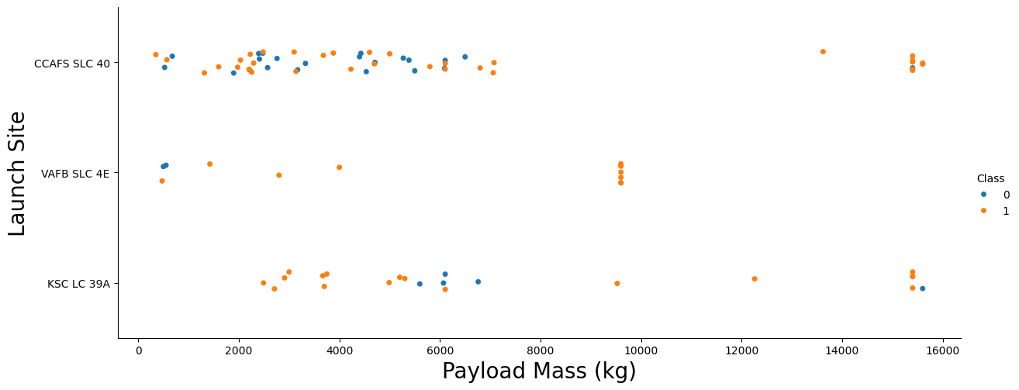
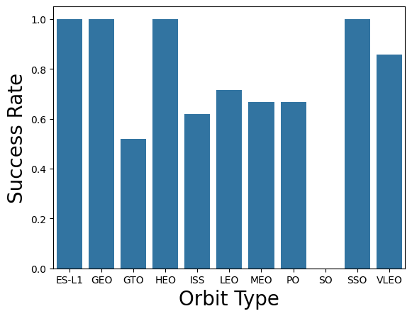
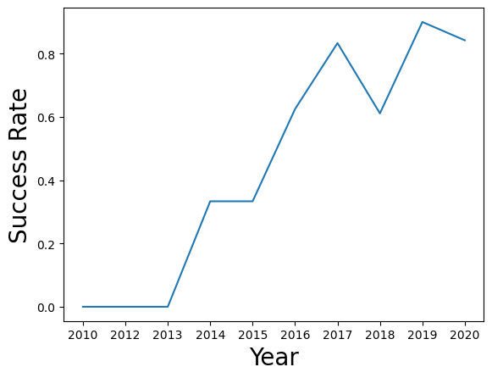
EDA with Data Visualization
We explored the data by visualizing the relationship between flight number and launch Site, payload and launch site, success rate of each orbit type, flight number and orbit type, the launch success yearly trend
https://github.com/pjwillcocks/Data-Science-Capstone-Project-/blob/9acdcea36d7045edb90a573b68ba1ed42a075b9f/5%20edadataviz.ipynb

Slide 12
EDA with SQL
We applied EDA with SQL to get insight from the data. We wrote queries to establish elements such as the following:
The names of unique launch sites in the space mission.
The total payload mass carried by boosters launched by NASA (CRS)
The average payload mass carried by booster version F9 v1.1
The total number of successful and failure mission outcomes
The failed landing outcomes in drone ship, their booster version and launch site names.
https://github.com/pjwillcocks/Data-Science-Capstone-Project-/blob/48851813f85aa047d3ae0a337874041cd807562a/4%20jupyter-labs-eda-sql-coursera_sqllite.ipynb

Slide 13
Build an Interactive Map with Folium
We marked all launch sites, and added map objects such as markers, circles, lines to mark the success or failure of launches for each site on the folium map.
We assigned the feature launch outcomes (failure or success) to class 0 and 1.i.e., 0 for failure, and 1 for success.
Using the color-labeled marker clusters, we identified which launch sites have relatively high success rate.
We calculated the distances between a launch site to its proximities. We answered some question for instance:
Are launch sites near railways, highways and coastlines.
Do launch sites keep certain distance away from cities.
https://github.com/pjwillcocks/Data-Science-Capstone-Project-/blob/9acdcea36d7045edb90a573b68ba1ed42a075b9f/6%20lab_jupyter_launch_site_location.ipynb

Slide 14
Build a Dashboard with Plotly Dash
We built an interactive dashboard with Plotly dash
We plotted pie charts showing the total launches by a certain sites
We plotted scatter graph showing the relationship with Outcome and Payload Mass (Kg) for the different booster version.
This combination allowed to quickly analyze the relation between payloads and launch sites, helping to identify where is best place to launch according to payloads.
https://github.com/pjwillcocks/Data-Science-Capstone-Project-/blob/9acdcea36d7045edb90a573b68ba1ed42a075b9f/7%20spacex_dash_app.py

Slide 15
Predictive Analysis (Classification)
We loaded the data using numpy and pandas, transformed the data, split our data into training and testing.
We built different machine learning models and tune different hyperparameters using GridSearchCV.
We used accuracy as the metric for our model, improved the model using feature engineering and algorithm tuning.
We found the best performing classification model
https://github.com/pjwillcocks/Data-Science-Capstone-Project-/blob/9acdcea36d7045edb90a573b68ba1ed42a075b9f/8%20SpaceX_Machine%20Learning%20Prediction_Part_5.ipynb

Slide 16
Results
Exploratory data analysis results
Space X uses 4 different launch sites;
The first launches were done to Space X itself and NASA;
The average payload of F9 v1.1 booster is 2,928 kg;
The first success landing outcome happened in 2015 fiver year after the first launch;
Many Falcon 9 booster versions were successful at landing in drone ships having payload above the average;
Almost 100% of mission outcomes were successful;
Two booster versions failed at landing in drone ships in 2015: F9 v1.1 B1012 and F9 v1.1 B1015;
The number of landing outcomes became as better as years passed.

Slide 17
Results
Using interactive analytics was possible to identify that launch sites use to be in safety places, near sea, for example and have a good logistic infrastructure around.
Most launches happens at east cost launch sites.

Slide 18
Results
Predictive Analysis showed that Decision Tree Classifier is the best model to predict successful landings, having accuracy over 87% and accuracy for test data over 94%.

Slide 19

Section 2

Slide 20
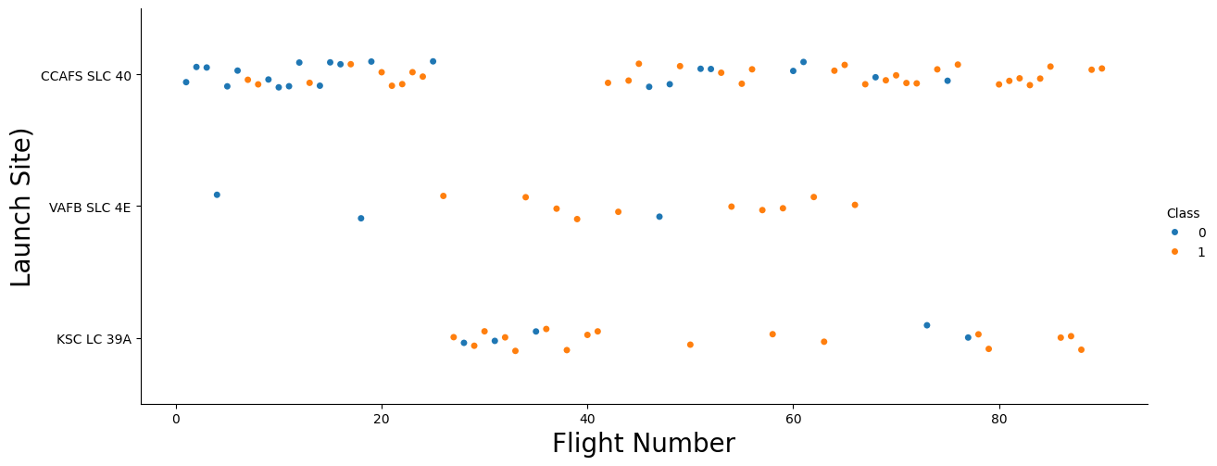
Flight Number vs. Launch Site
According to the plot above, it’s possible to determine that the most frequently used launch site currently is CCAF5 SLC 40, and most of recent launches were successful;
In second place VAFB SLC 4E and third place KSC LC 39A;
It’s also possible to see that the general success rate improved over time.

Slide 21
Payload vs. Launch Site
Majority of payloads are under 8000kg
Payloads over 9,000kg though have high success rate;
Payloads over 10,000kg seems only to be possible from CCAFS SLC 40 and KSC LC 39A launch sites.

Slide 22
Success Rate vs. Orbit Type
The following orbits have 100% success rate:
ES-L1
GEO
HEO
SSO
Followed by:
VLEO (above 80)
LFO (above 70%)

Slide 23
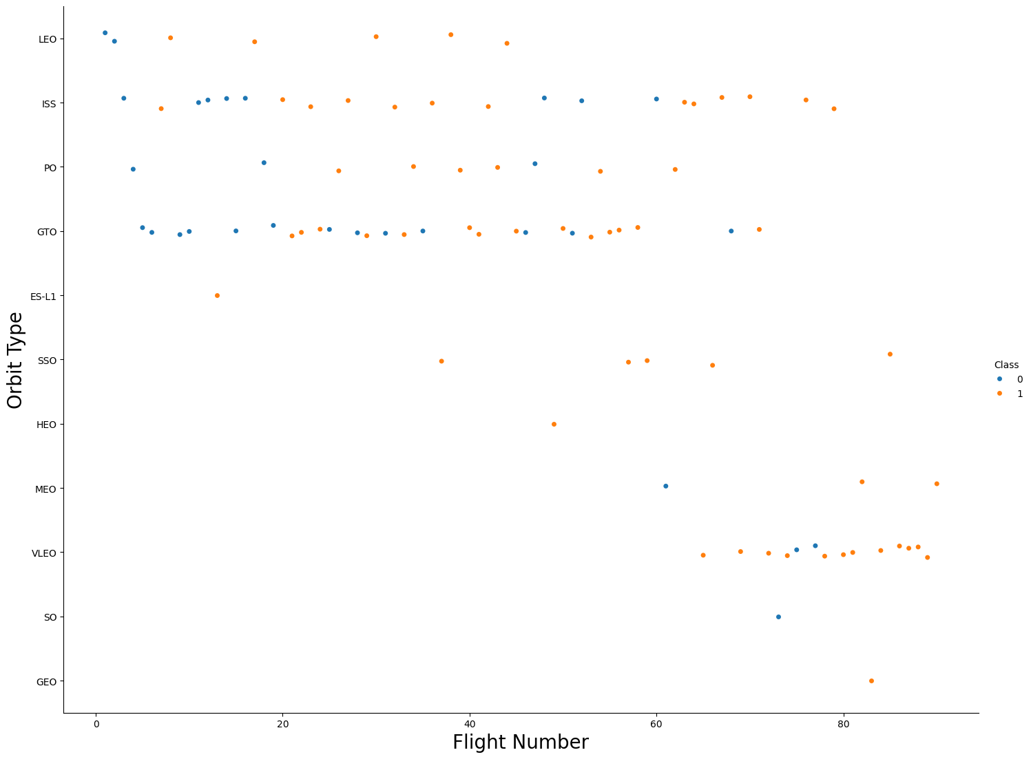
Flight Number vs. Orbit Type
Success rate appears to have improved over time to all orbits
The launches to different orbits changes over time with the VLEO now the most popular orbit for launch

Slide 24
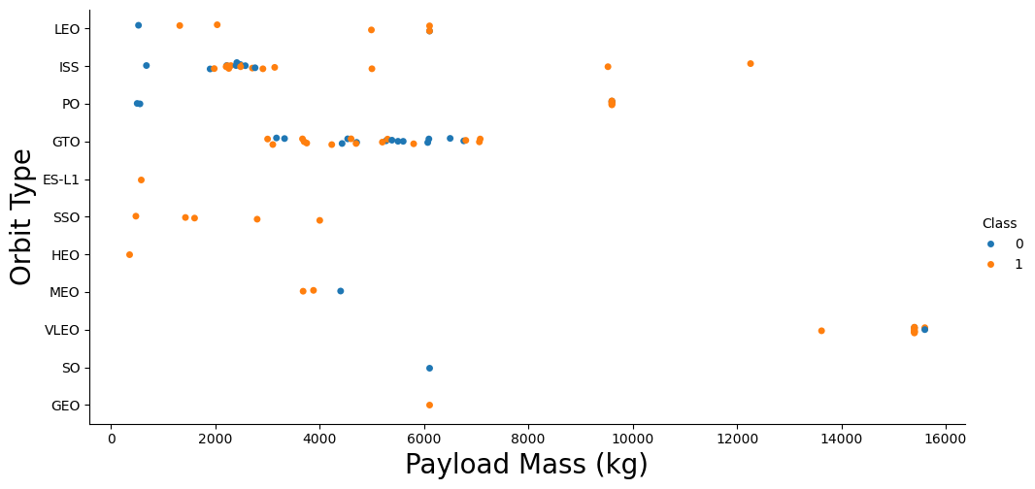
Payload vs. Orbit Type
Seemingly there is no clear relation between payload and success rate to orbit GTO
ISS orbit has the widest range of payload and a good rate of success
There are few launches to the orbits SO and GEO
The highest payloads are launched to VLEO orbit

Slide 25
Launch Success Yearly Trend
Success rate has seen a general sharp increase over time
Decreases in success rate however occurred in 2018 and 2020

Slide 26
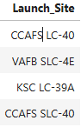
All Launch Site Names
%sql SELECT DISTINCT Launch_Site FROM SPACEXTABLE
Using sqlite3 and line magic (%sql) an SQL query was directly
written into the python notebook to extract distinct launch sites
from the connection to the spaceX table

Slide 27
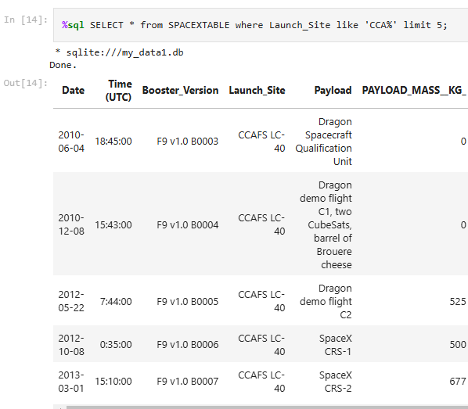
Launch Site Names Begin with 'CCA'
Sql query written in Python notebook to obtain the first 5 rows of the table where launch site column contains “CCA”

Slide 28
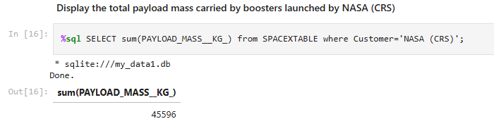
Total Payload Mass
SQL query sum column PAYLOAD_MASS__KG_ to give the total payload launched from all boosters launched by NASA (CRS)

Slide 29
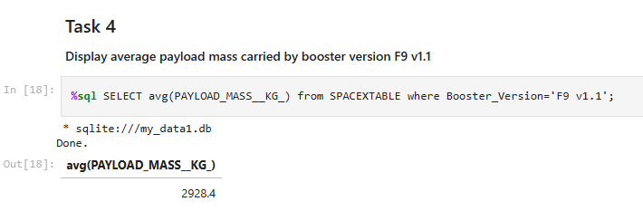
Average Payload Mass by F9 v1.1
SQL query to show the average payload by mass carried by the F9 v1.1 booster

Slide 30
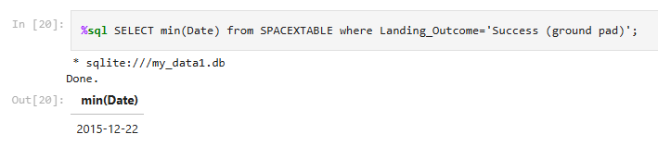
First Successful Ground Landing Date
SQL query to show the first successful landing on the ground pad

Slide 31
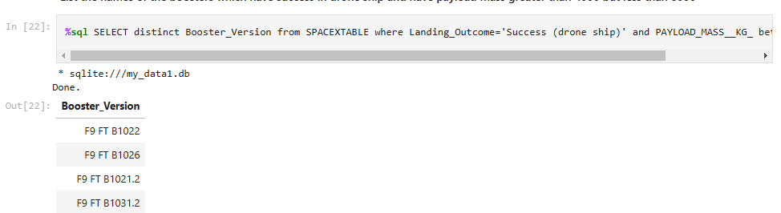
Successful Drone Ship Landing with Payload between 4000 and 6000
SQL query to determine names of boosters which have successfully landed on drone ship and had payload mass greater than 4000 but less than 6000

Slide 32
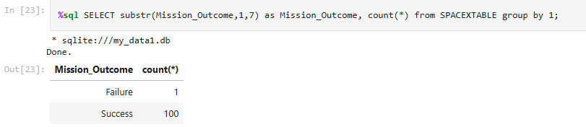
Total Number of Successful and Failure Mission Outcomes
SQL query the total number of successful and failure mission outcomes

Slide 33
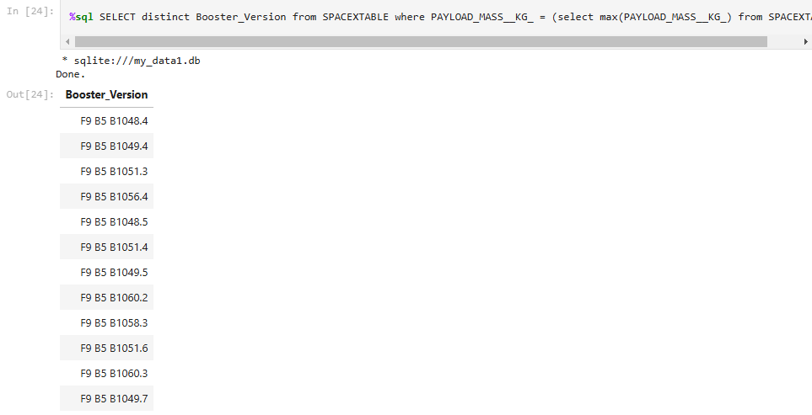
Boosters Carried Maximum Payload
SQL query showing the names of the booster which have carried the maximum payload mass

Slide 34
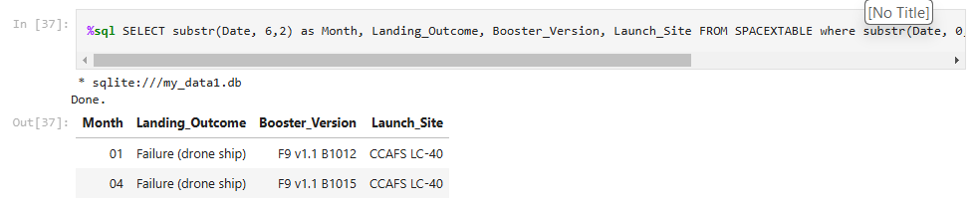
2015 Launch Records
SQL query showing the failed landing_outcomes in drone ship, their booster versions, and launch site names for in year 2015

Slide 35
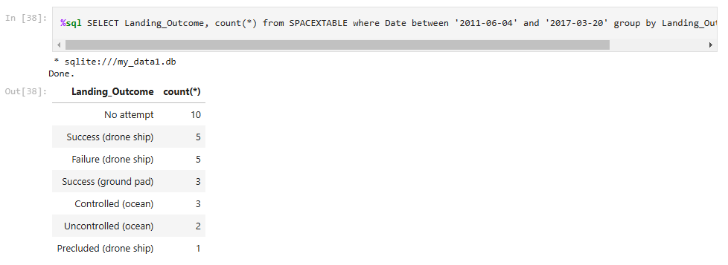
Rank Landing Outcomes Between 2010-06-04 and 2017-03-20
SQL query showing the count of landing outcomes (such as Failure (drone ship) or Success (ground pad)) between the date 2010-06-04 and 2017-03-20, in descending order

Slide 36

Section 3

Slide 37

All launch sites
Launch sites located on west and east coasts close to sea and nearby major conurbations

Slide 38

Launch Outcomes by Site
Drilled down view of map including markers showing launch outcomes at each site

Slide 39
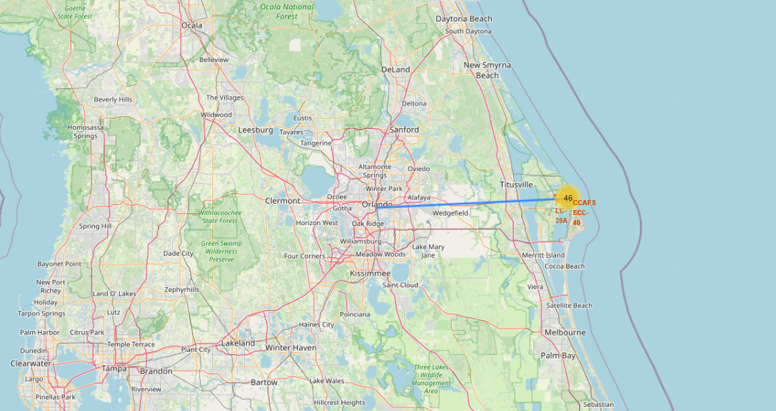
Launch site distance to major cities
Drilled down view showing line demonstrating distance from launch site to nearest city

Slide 40

Section 4

Slide 41
Successful Launches by Site
KSC LC-39A has the highest number of successful launches with CCAFS SLC-40 the least and significantly lower

Slide 42
Site with Highest Launch Success Ratio
Site KSC LC-39A had the highest success ratio of all sites at 76.9%

Slide 43

Success and Payload
Success rate for low weighted payloads are higher than heavy payloads

Slide 44

Section 5

Slide 45
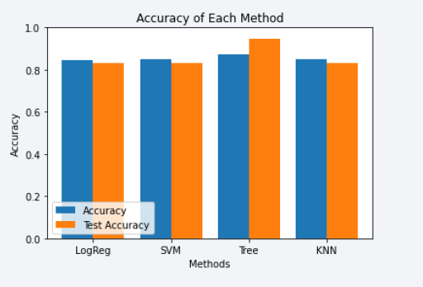
Classification Accuracy
The model with the highest classification accuracy is Decision Tree Classifier, which has accuracies over than 87%.

Slide 46
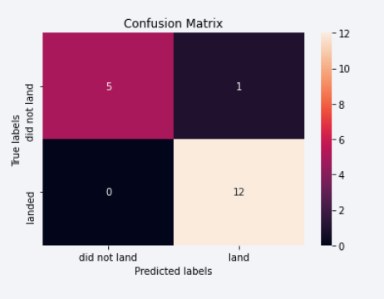
Confusion Matrix
Confusion matrix of Decision Tree Classifier proves its accuracy by showing the big numbers of true positive and true negative compared to the false ones.

Slide 47
Conclusions
The best launch site is KSC LC-39A
Launches above 7,000kg are less risky
Although most of mission outcomes are successful, successful landing outcomes seem to have improved over time.
Decision Tree Classifier is the best model that can be used to predict successful landings and increase profits.

Slide 48
Appendix
As an improvement for model tests, it’s important to set a value to np.random.seed variable;
Folium didn’t show maps on Github, so I took screenshots.

Slide 49


